Slide 1
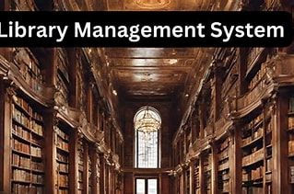
LIBRARY MANAGEMENT SYSTEM IN C USING STRUCTS
Team Members: Rohan Patil -1262252816 Rajganesh Reddy-1262251774 Shreyas Bhat-1262252958 Sarvesh Shinde-1262252496 Pranjal- 1262253585

Slide 2

TOPICS COVERED IN THIS PRESENTATION
TOPICS COVERED IN THIS PRESENTATION
INTRODUCTION
PROBLEM STATEMENT
OBJECTIVES OF THE LIBRARY MANAGEMENT SYSTEM
SCOPE OF THE SYSTEM
TOOLS AND TECHNOLOGIES USED
WORKFLOW OF THE SYSTEM
FLOWCHARTS
ALGORITHM
MODULE-WISE EXPLANATION
ADMIN MODULE
USER MODULE
PAYMENT MODULE
FILE HANDLING MODULE
CONCLUSION

Slide 3
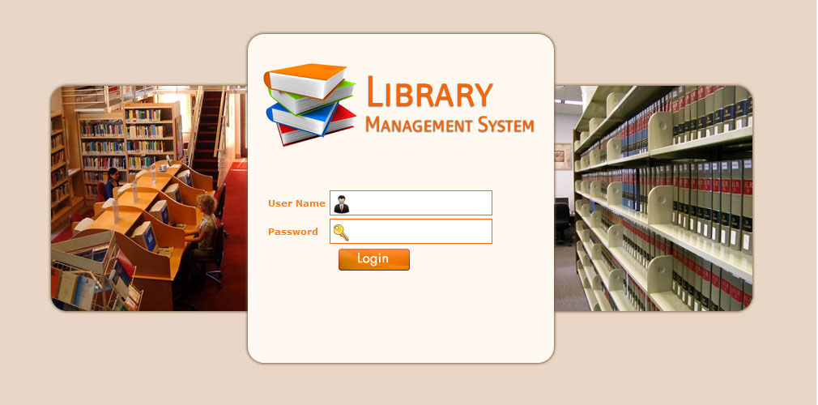
INTRODUCTION OF LIBRARY MANAGEMENT SYSTEM
A Library Management System is a computerized system used to manage library activities
It helps in maintaining records of books, users, issue, and return operations
Reduces manual work and minimizes errors
Provides fast and accurate access to library information
Developed using the C programming language
Uses structures to store and organize data efficiently
Suitable for small libraries and academic projects
Helps students understand core concepts of C programming

Slide 4

PROBLEM STATEMENTS FOR LIBRARY MANAGEMENT SYSTEM
Traditional library management is carried out manually
Maintaining book and user records on paper is difficult
Manual record keeping is time-consuming
High chances of errors and data loss
Searching book details takes more time
Issue and return of books is not properly tracked
A computerized Library Management System is required

Slide 5
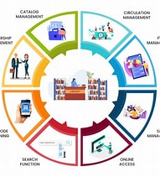
OBJECTIVE OF LIBRARY MANAGEMENT SYSTEM USING C LANGUAGE
To develop a simple Library Management System using C
To use structures for organizing library data
To store and manage book details efficiently
To maintain user information accurately
To implement book issue and return operations
To reduce manual work and errors
To understand basic programming concepts in C

Slide 6

SCOPE OF LIBRARY MANAGEMENT SYSTEM
Manages basic library operations efficiently
Stores and maintains book records
Maintains user information
Supports issuing of books to users
Handles return of issued books
Provides book search functionality
Suitable for small libraries and academic projects

Slide 7
WORKFLOW OF THE LIBRARY MANAGEMENT SYSTEM
The system starts and displays the Main Menu (Admin Login, User Login, User Registration, Exit)
Admin Login
Admin enters username and password
If credentials are valid → Admin Menu is displayed
If invalid → Access is denied
Admin Operations
Admin can add new books to the system
Admin can view all available books
Admin can view registered users
Admin can view all buy and rent transactions
User Registration
New user enters username and password
User details are stored in the system
User Login
User enters login credentials
If valid → User Menu is displayed
If invalid → Login is rejected

Slide 8
WORKFLOW OF THE LIBRARY MANAGEMENT SYSTEM
User Operations
User can view available books
User can choose to buy or rent a book
User selects payment mode (Credit / QR)
Payment & Transaction Processing
Payment confirmation is requested
If payment is approved → Transaction is recorded
If payment fails → Operation is cancelled
The system updates records and displays confirmation messages
User or Admin can logout, and the system returns to the Main Menu

Slide 9
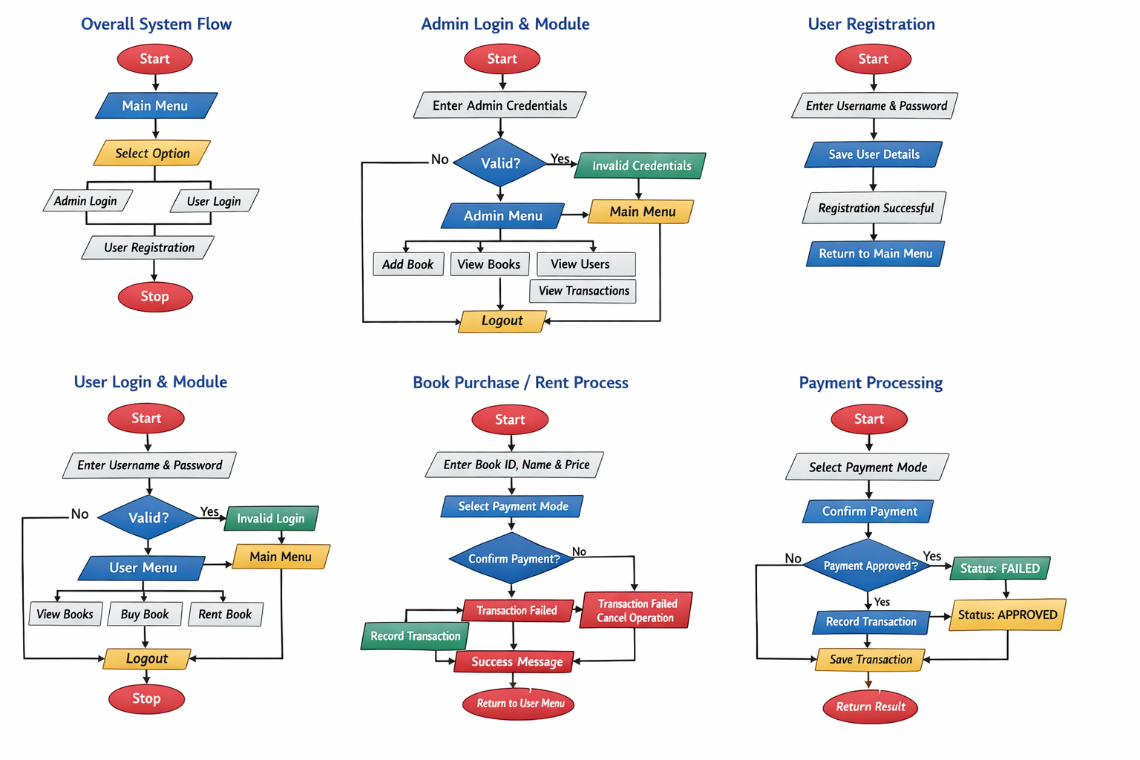

Slide 10
ALGORITHM: LIBRARY MANAGEMENT SYSTEM
ALGORITHM: LIBRARY MANAGEMENT SYSTEM
Step 1: Start
Begin execution of the program
Display the Main Menu
Step 2: Display Main Menu
Show options:
Admin Login
User Login
User Registration
Exit
Step 3: Admin Login
Read admin username and password
If credentials are valid:
Display Admin Menu
Else:
Display error message and return to Main Menu
Step 4: Admin Operations
Admin selects one option:
Add Book
View Books
View Registered Users
View Transactions
Perform selected operation
Repeat until admin chooses Logout

Slide 11
ALGORITHM: LIBRARY MANAGEMENT SYSTEM
STEP 5: USER REGISTRATION
Accept username and password
Store user details in file
Return to Main Menu
STEP 6: USER LOGIN
Read login credentials
Validate from file
If valid, display User Menu
STEP 7: USER OPERATIONS
View books
Buy or Rent book
Proceed to payment
STEP 8: PAYMENT PROCESS
Select payment mode
Confirm payment
Approve or fail transaction
STEP 9: TRANSACTION STORAGE
Save transaction details in file
Display confirmation message
STEP 10: LOGOUT / EXIT
User or Admin logs out
Return to Main Menu or Exit
STEP 11: STOP
End program execution

Slide 12
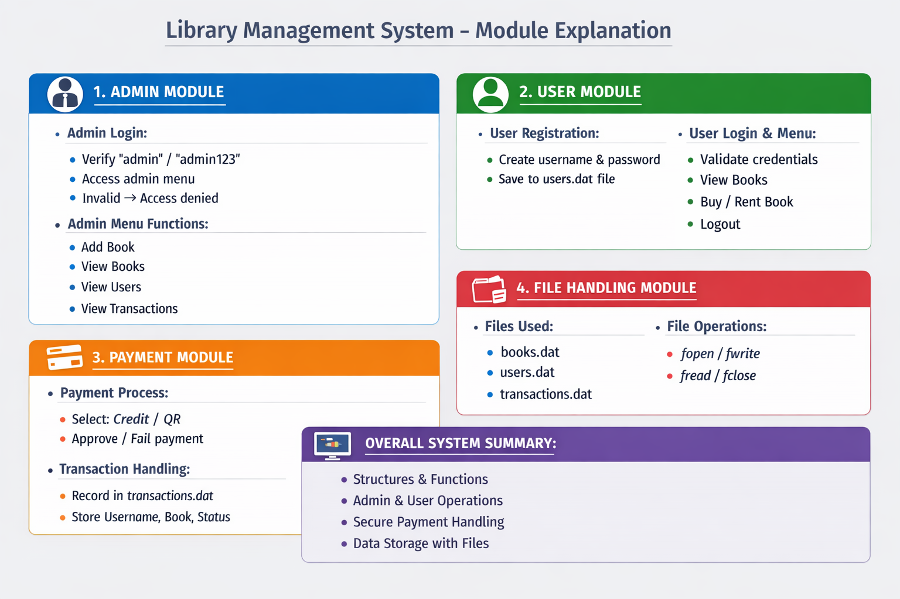

Slide 13
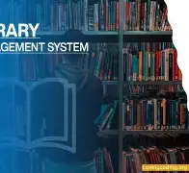
CONCLUSION FOR LIBRARY MANAGEMENT SYSTEM
The Library Management System automates basic library operations
It reduces manual work and minimizes errors
The system efficiently manages books, users, and transactions
Structures in C help organize and manage data effectively
File handling ensures permanent storage of records
Admin and User modules provide controlled access
The project improves understanding of C programming concepts

Slide 14


